Slide 1
Bayesian Linear Regression of Simulated Diffraction Measurements for Residual Stress Analysis
Student: Farah Hassan
Academic Supervisor: Dr. Matthew Peel
Notes:
To do:
Audio

Slide 2
Agenda
Project Aims: Can Bayesian Regression Aid in the Stress Analysis of Nuclear Materials?
Context: Stress Analysis using Diffraction
Procedure: Simulating then Fitting Strain ‘Measurements’ using Bayesian Linear Regression
Results: Comparing Bayesian to the Industry Standard, Least Squares
Implications of Bayesian Regression for the Nuclear Industry
Notes:
To do:
Audio
Review order

Slide 3
Project Aims
The project aims to determine whether Bayesian linear regression of X-Ray diffraction measurements can aid in the stress analysis of materials with complex grain structures.
Notes:
To do:
Audio
What is Baysian (Quick)

Slide 4
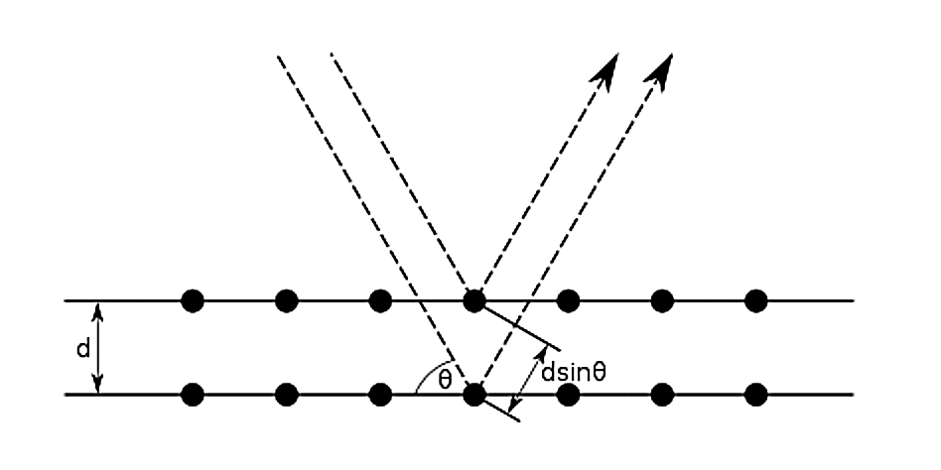
Context: Stress Analysis Using Diffraction
Bragg Diffraction¹
Notes:
To do:
Audio
Animations?

Slide 5
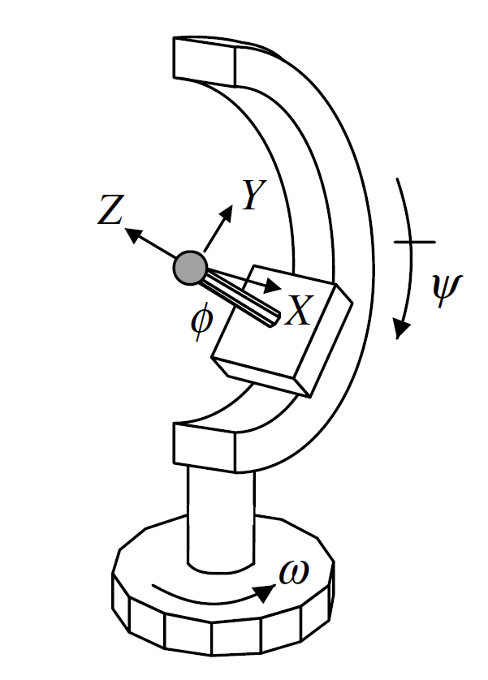
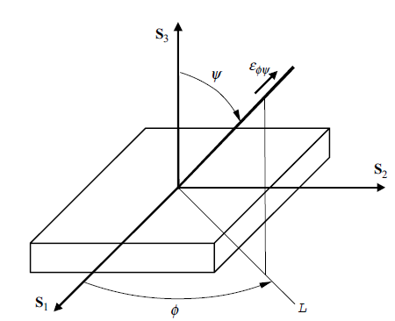
Context: Stress Analysis Using Diffraction
Goniometer²
Bragg Diffraction¹
Notes:
To do:
Audio
Animations?

Slide 6
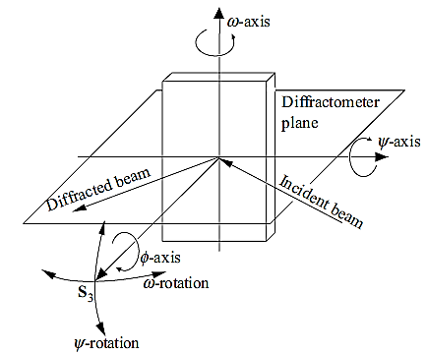
Context: Stress Analysis Using Diffraction
Goniometer²
Sample Co-ordinates³
Bragg Diffraction¹
1. H. P. Myers (2002). Introductory Solid State Physics. Taylor & Francis.
2. He, B. B., 2009. Two-Dimentional X-Ray Diffraction. 1 ed, page: 140
3. He, B. B., 2009. Two-Dimentional X-Ray Diffraction. 1 ed, page: 262
Notes:
To do:
Audio
Animations?

Slide 7
Context: Stress Analysis Using Diffraction
εφψ
Strain for one location, εφψ
If 6 locations are measured, this equation can be solved using linear regression to obtain a stress tensor.
He, B. B., 2009. Two-Dimentional X-Ray Diffraction. 1 ed, page: 262
Notes:
To do:
Audio
Referencing

Slide 8
Context: Stress Analysis Using Diffraction
εφψ
Strain for one location, εφψ
If 6 locations are measured, this equation can be solved using linear regression to obtain a stress tensor.
Stress Coefficients, Pij
These oscillate with the detector angle, γ, and incorporate the material’s macroscopic constants.
He, B. B., 2009. Two-Dimentional X-Ray Diffraction. 1 ed, page: 262
Notes:
To do:
Audio
Referencing

Slide 9
Context: Stress Analysis Using Diffraction
εφψ
Stress Tensor Components, σij
Strain for one location, εφψ
If 6 locations are measured, this equation can be solved using linear regression to obtain a stress tensor.
Stress Coefficients, Pij
These oscillate with the detector angle, γ, and incorporate the material’s macroscopic constants.
He, B. B., 2009. Two-Dimentional X-Ray Diffraction. 1 ed, page: 262
Notes:
To do:
Audio

Slide 10
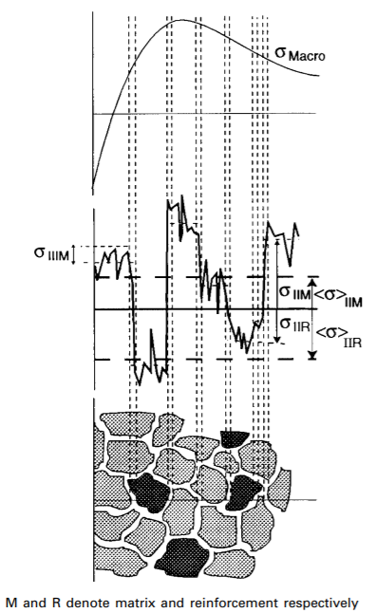
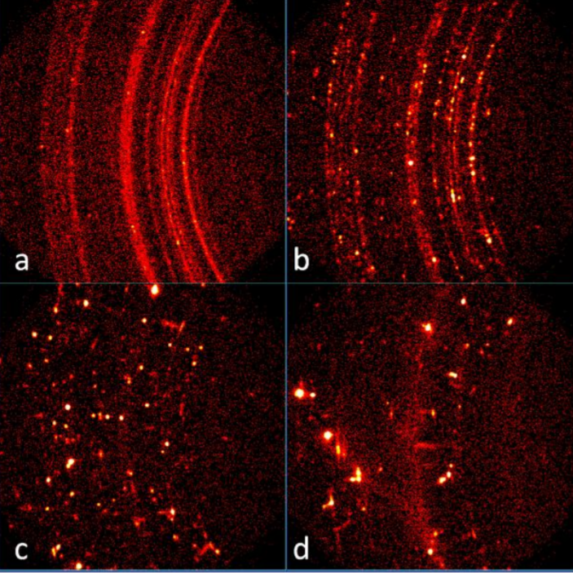
Context: Origin of Uncertainties in Measurements
Nuclear materials have non-uniform grain structures.
There is variation in intergranular stress.
If a large grain has an abnormally high or low stress, the intensity of the skewed peak will be high, overshadowing smaller, more representative grains.
Bramble, S., Flemming, R. and Mccausland, P. (2014). GRAIN SIZE, “SPOTTY” XRD RINGS, AND CHEMIN: TWO-DIMENSIONAL X-RAY DIFFRACTION AS A PROXY FOR GRAIN SIZE MEASUREMENT IN PLANETARY MATERIALS. M.
Withers, P.J. and Bhadeshia, H.K.D.H. (2001). Residual stress. Part 1 – Measurement techniques. Materials Science and Technology, 17(4), pp.355–365.
Notes:
To do;
Audio

Slide 11
Project Aims
The project aims to determine whether Bayesian linear regression of X-Ray diffraction measurements can aid in the stress analysis of materials with complex grain structures.
Criteria for Success:*
Accuracy of Stress estimate
Representation of Confidence Intervals
Ease of Implementation
* Relative to Least-Squares regression
Notes:
Key Points:
Reasons why Bayesian may be more useful than the industry standard, which is OLS
Can be made to be less sensitive to outliers
NOT NECESSARILY NORMALLY DISTRIBUTED ERRORS
Returns a full distribution, rather than a single value with standard deviation
THE RESULT IS NOT NECESSARILY NORMALLY DISTRIBUTED
Better understanding of errors.
Criteria:
results needs to be as good as OLS, minimum
Confidence intervals and errors need to be more representative of true uncertainty
Practicality is important for the industry.
To do:
Audio.

Slide 12
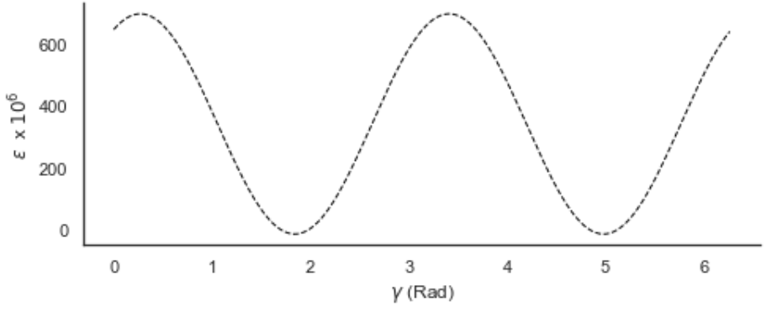
Methodology
A strain distribution was generated using a known stress tensor.
Noise was added to the strain, creating “strain measurements”.
True strain distribution.
σ₁₁ ₌ 150, σ₁₂ ₌ 30, σ₂₂ ₌ 50 MPa
The result was analysed in reference to the original stress tensor.
Using linear regression, stress tensor components were solved for.
Notes:
To do:
Audio

Slide 13
Methodology
2. Noise was added to the strain, creating “strain measurements”.
True strain distribution.
σ₁₁ ₌ 150, σ₁₂ ₌ 30, σ₂₂ ₌ 50 MPa
1. A strain distribution was generated using a known stress tensor.
3. The result and uncertainty was analysed in reference to the original stress tensor.
4. Using linear regression, stress tensor components were solved for.
Notes:
To do:
Audio

Slide 14
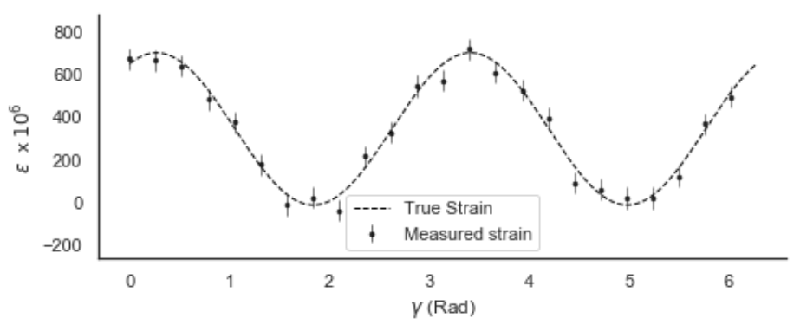
Methodology
A strain distribution was generated using a known stress tensor.
Noise was added to the strain, creating “strain measurements”.
The result was analysed in reference to the original stress tensor.
Using linear regression, stress tensor components were solved for.
Notes:
KEY POINTS:
Recall that strain oscillates with detector angle.

Slide 15
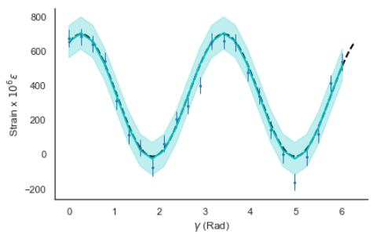
Methodology
A strain distribution was generated using a known stress tensor.
Noise was added to the strain, creating “strain measurements”.
Least-Squares fitted strain distribution. σ₁₁ ₌ 150.6, σ₁₂ ₌ 30.23, σ₂₂ ₌ 47.2 MPa
The result was analysed in reference to the original stress tensor.
Using linear regression, stress tensor components were solved for.
Notes:
To do:
Audio
Fix label
Add s11

Slide 16
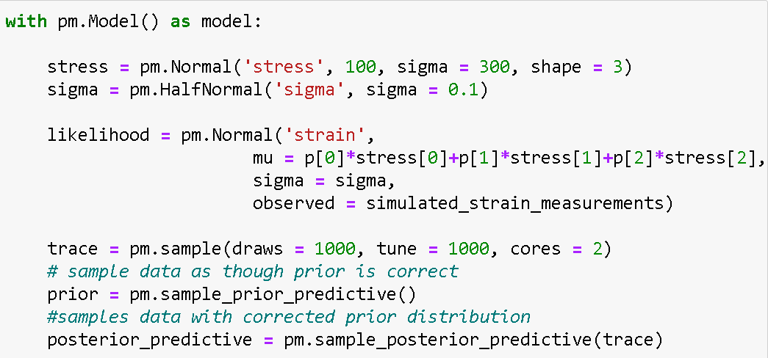
Methodology
Least-Squares Regression
Bayesian Regression
Prior Distribution
Likelihood Function
Notes:
To do:
Audio
Mention stacks

Slide 17
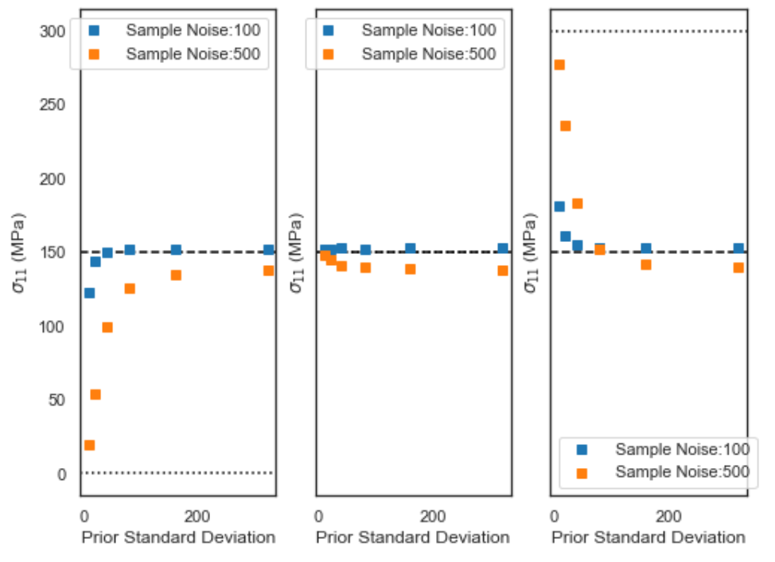
Effect of Prior Distribution
Prior stress = 0 MPa
Prior stress = 150 MPa (= true stress)
Prior stress = 300 MPa
Notes:
To do:
Audio
Measurements with more variation lead to fits which are more influenced by the prior distribution
For this case plateu at around 100- 200 , so we know that if a numerical prior is set in that region it will not skew the results.

Slide 18
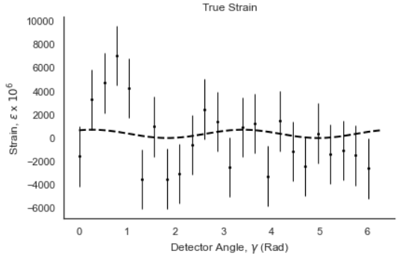
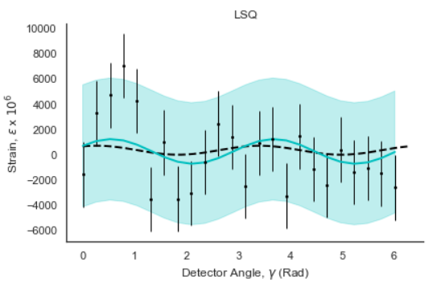
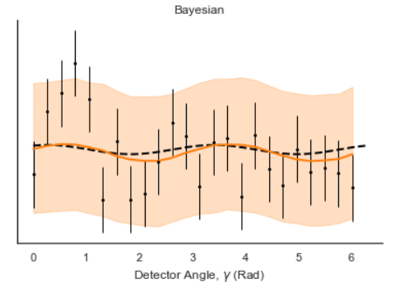
Bayesian VS Least-Squares:
Normally Distributed Likelihood
Stress Tensor Component | True Stress, MPa | Bayesian Fitted Stress, MPa | Error, Std dev. | Least-Squares Fitted Stress, MPa | Error, Std dev.
s11 | 150 | 144.7 | 101.7 | 145.5 | 91.12
S22 | 50 | 1.4 | 102.1 | -0.6 | 91.12
s12 | 30 | 143.1 | 60.4 | 142.8 | 56.7
Notes:
To do:
Audio
95% confidence interval
Emphasise that if it was another distribution with the same noise the result would be off by a different amount and potentially in a different direction.

Slide 19
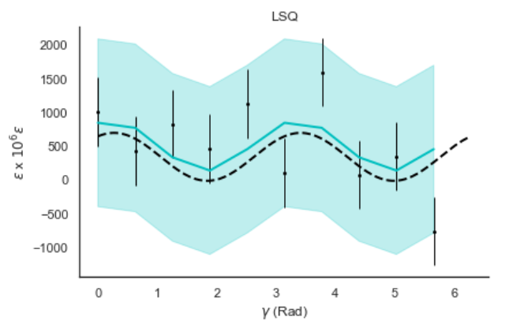
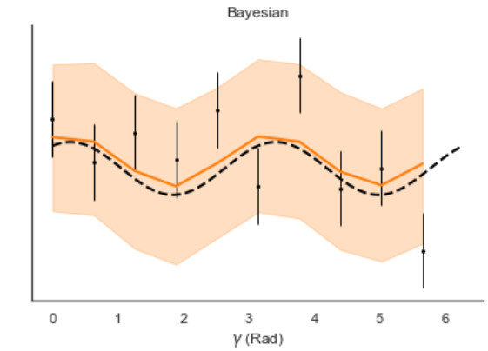
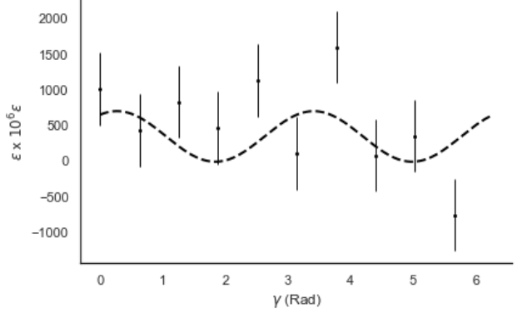
Bayesian VS Least Squares:
Normally Distributed Likelihood
Stress Tensor Component | True Stress, MPa | Bayesian Fitted Stress, MPa | Error, Std dev. | Least-Squares Fitted Stress, MPa | Error, Std dev.
s11 | 150 | 204.1 | 28.8 | 204.3 | 34.9
S22 | 50 | 94.5 | 29.5 | 93.6 | 34.9
s12 | 30 | 27.4 | 20.0 | 27.3 | 21.7
Notes:
To do:
Audio
95% confidence interval
Emphasise that if it was another distribution with the same noise the result would be off by a different amount and potentially in a different direction.

Slide 20
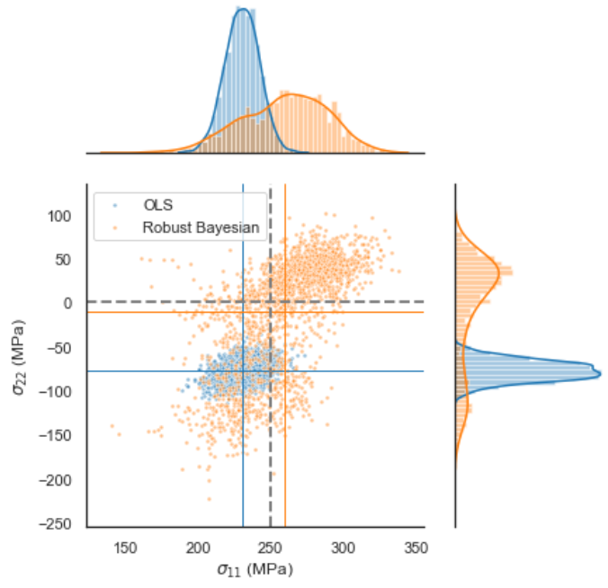
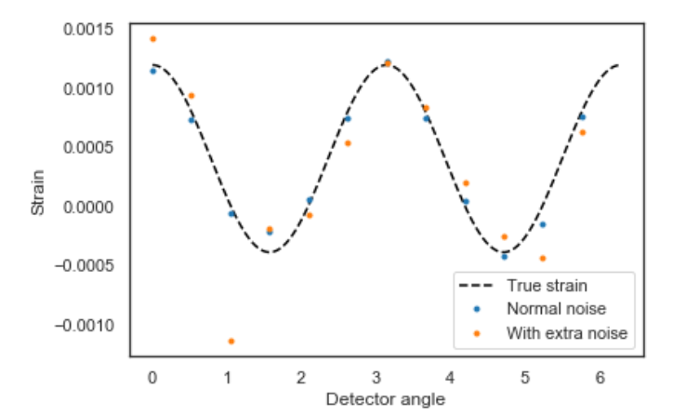
Bayesian VS Least-Squares:
Student_t Likelihood Function
The ability to see this bi-modal distribution is valuable. There is a possibility that the outliers are correct.
Least-Squares’ fitted stress is not only less accurate than Bayesian’s, but more certain that it is correct.

Slide 21
Conclusions
If the prior is non-restrictive, numerical changes in the prior distribution have a marginal effect on Bayesian fit outcomes, relative to changes in likelihood function.
With a Normally distributed likelihood function and a non-restrictive prior, Bayesian regression yields similar results to Least-Squares.
Robust Bayesian regression, wherein the likelihood function is a student_t distribution, can yield more accurate results as it has more success in handling outliers.
Bayesian can be used to better understand uncertainties, which can lead to variation in operational life estimates for nuclear materials.
Notes:
Numerical changes in the prior distribution have a marginal effect on the fit outcomes relative to changes in the type of distribution of the likelihood function.
Bayesian fitting without a restrictive prior or a likihood function which isn’t normal is just like OLS
Robust Bayesian fitting, wherein the likelihood function is not Normally Distributed can yield more accurate results than OLS with more realistic confidence intervals
This has been the case in measurements with extreme outliers3.
3. In the nuclear Industry, Bayesian can be used to better understand confidence intervals, which can lead to significant variations in operation life of materials.
To do:
Slide
Audio

Slide 22
Thank you

